Slide 1
Biogen
Bristol-Myers Squibb
TEAM
Lisa Patel
Mukesh Ganesh
Resham Uttamchandani

Slide 2

Pharmaceutical Industry
Drug development
Manufacture drug
Test drugs on subjects
FDA approval
Marketing
Sell new drugs in market

Slide 3
Pharmaceutical Industry
PHASE I
PHASE II
PHASE III
Consists of less than 30 subjects [1]
End goal is to figure out dosage capacity that is safe for subjects
Consists of less than 100 subjects
End goal is to figure out how treatment reacts on body
Consists of 100 to 1000s of subjects
End goal is make sure new drug has positive effect on different group of people

Slide 4

Pharmaceutical Industry
New drugs are tested on humans and/or animals before releasing it for direct use
Clinical trials are conducted in the form of phases
Once a phase is tested and approved by FDA, companies can move on to next phase
Usually there are 3-4 phases but it’s timeline varies
All new drugs have to be approved by FDA

Slide 5
Key Competitors
Novartis
Roche
Pfizer
Sanofi
Merck
GSK (GlaxoSmithKline)
Bayer
Amgen

Slide 6
Key Drivers
Increase in population [2]
Average age of people [2]
Strong competition
Increase in chronic diseases
Awareness about clinical trials

Slide 7
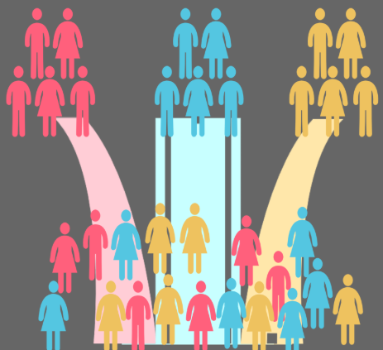
Key Challenges
Government regulations
Changes in policy
Lag in getting approval for drugs
Integration with technology
Increase in generic drug [3]
Expiring patents [3]
Extended timeline of phase 3/4
Cost of drug
Brexit

Slide 8
Biogen
Started on: 1978 (from merger)
Biogen manufactures drugs and is specialized in the discovery, development, and delivery of therapies for the treatment of neurological diseases to patients worldwide
The company ranked 245 on the 2018 Fortune 500 list of the largest United States corporations by revenue in 2018

Slide 9
Biogen - Timeline [9]
1978
Biogen was established
1983
Biogen became public
1989
Hepatitis B vaccine having Biogen’s technology got approved by FDA
1996
Biogen received FDA approval of interferon beta-1a for multiple sclerosis
1998
Biogen received National Medal of Technology award
2005
Biogen removed natalizumab drug from market as it was suspected to cause serious side effect
2010
Biogen received FDA approval of rituximab for treatment of chronic lymphocytic leukemia
2014
Biogen received FDA approval for treatment of hemophilia A and B. Peginterferon beta-1a was approved for treatment of relapsing forms of MS

Slide 10
Bristol-Myers Squibb (BMS)
Started on: 1989 (from merger)
Bristol-Myers Squibb manufactures prescription pharmaceuticals and biologics in several therapeutic areas, including cancer, HIV/AIDS, cardiovascular disease, diabetes, hepatitis, rheumatoid arthritis and psychiatric disorders.
Bristol-Myers Squibb ranked 145th on the Fortune 500 list of the largest United States corporations by revenue in 2018

Slide 11
BMS - Timeline [4]
1989
Mristol-Myers merged with Squibb
1991
BMS received FDA approval of TAXOL and VIDEX
1994
BMS received approval of GLUCOPHAGE
1997
BMS received approval of AVAPRO and PLAVIX
1998
BMS received National Medal of Technology award
2002
BMS received FDA approval of ABILIFY
2006
BMS received FDA approval of SPRYCEL and ATRIPLA
2015
BMS received FDA approval of EVOTAZ

Slide 12
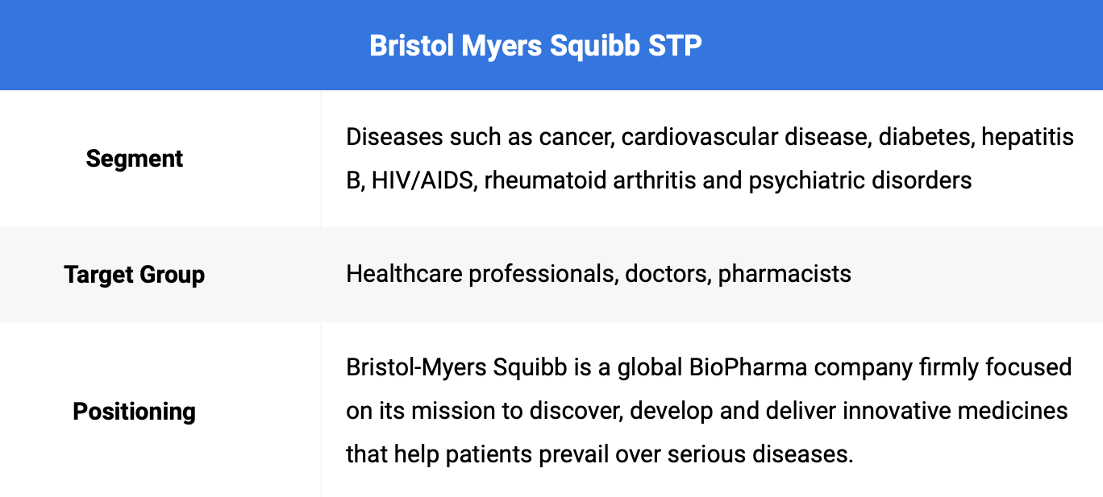
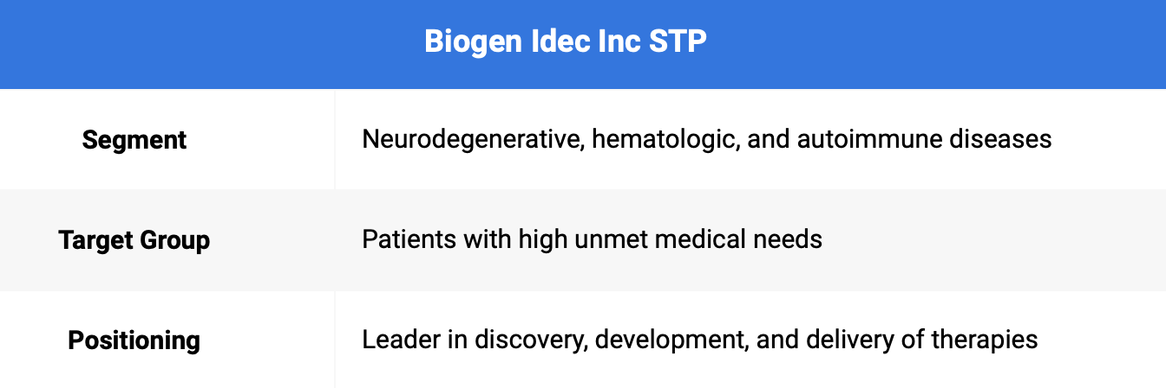
Segment, Target groups & Positioning of the companies

Slide 13
Street’s position
and expectations

Slide 14
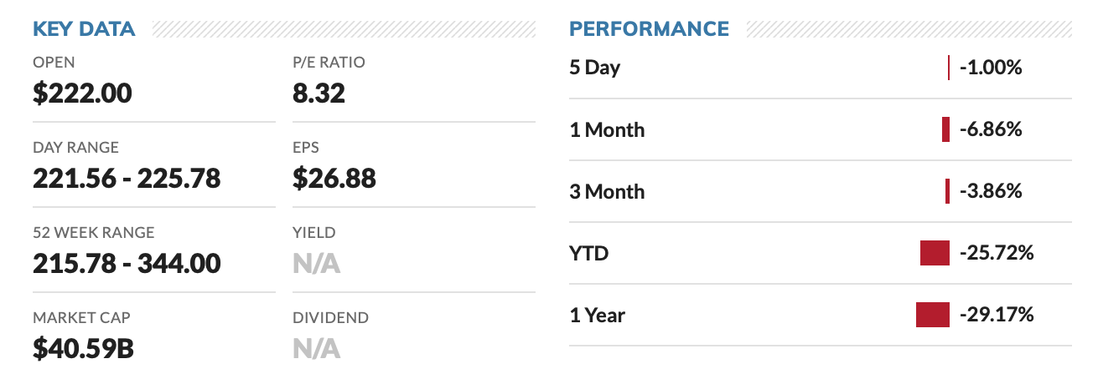
Biogen- Key Data for stock price & Stock performance
Yahoo Finance :
“Biogen Inc. is expected to report adjusted net income of $1.5 billion, or $8.28 a share, on sales of $3.5 billion, based on a FactSet survey of 25 analysts. Quarterly estimates have risen 5.3 cents a share in the past month.”
Market Insider :
“Biogen said it expects yearly revenue to land between $14 billion and $14.2 billion, up from previous estimates ranging from $13.6 billion to $13.8 billion.”

Slide 15
Biogen Inc. Sales VS its Competitors
As we compare Biogen’s results to its competitors, Total revenue in 2rd quarter 2019 is increased by 7.75% year on year, while most of its other competitors experienced revenues by -4.23% contraction. Both recorded in same quarter.
Net Income of Biogen in 2rd quarter 2019 grew by 63.29% year on year, faster than the growth of its competitors which was 21.6%.
The net margin of the company was achieved 41.31% as more profitable compared to its competitors in 2rd quarter 2019.

Slide 16
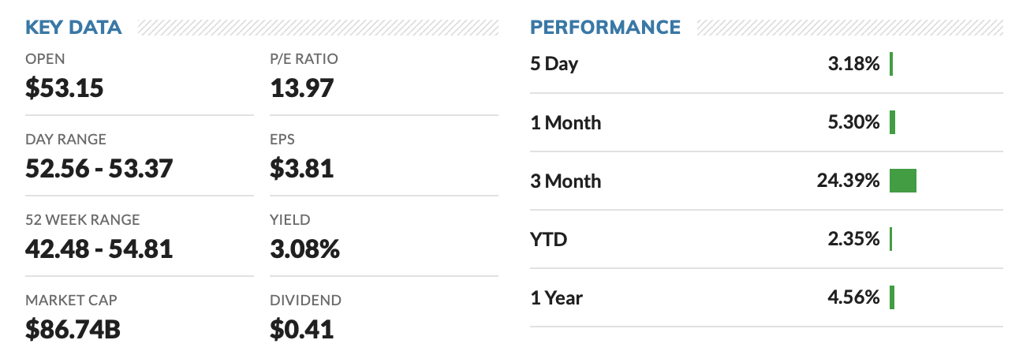
BMS- Key Data for stock price & Stock performance
CNN BUSINESS:
“The 9 analysts offering 12-month price forecasts for Bristol-Myers Squibb Co have a median target of 59.00, with a high estimate of 75.00 and a low estimate of 48.84. The median estimate represents a +10.90% increase from the last price of 53.20.”

Slide 17
Bristol Myers Squibb Co’s(BMS) VS its Competitors
As we compare BMS results to its competitors, Total revenue in 2rd quarter 2019 is increased by 9.98% year on year, while most of its other competitors experienced revenues by -9.56% contraction. Both recorded in same quarter.
BMS’s Net Income in 2rd quarter 2019 grew by 276.7% year on year, faster than the average growth of its competitors which was 33.05%.
The net margin of the company was 22.94% as reported lower profitable compared to its competitors in 2rd quarter 2019.

Slide 18
Specifics of the risks, business segmentation delineated, the executive compensation structure and a summary of their earnings call for the second quarter 2019
FOR
Bristol Myers Squibb &
Biogen

Slide 19
Risk Factors
BIOGEN
Changing regulatory rules in different countries across the world
Failure of new drugs in testing and trial cost company millions of dollars
Market Share is Limited
Competitors of the company have increased brand awareness in the market as compared to Biogen.
Bristol Myers Squibb
Dependencies are strong on working with third parties to enhance and improve abilities
The company acquires technology ,biotech companies, and expertise and hence a threat to its culture is ever more.
Price pressure due to in decrease prices of competitors

Slide 20
Biogen
Business segmentation
&
Earnings call Summary

Slide 21
Business segmentation
Maximize MS(multiple sclerosis) core business: Delivered a all time high revenue to $2.4 billion in the second quarter 2019.
Accelerating neuromuscular franchise: Spinraza revenue grew by 15%.
Developing and expanding neuro science portfolio- Added 17 clinical programs in the past 2 years
Unlock the potential of biosimilars: Biosimilar revenue grew 45% to $184 million in the second quarter 2019.
Continuous improvement and diligent capital allocation: Generated $2 billion in net cash flows from operations.

Slide 22
Earnings call Summary
Was approximately $2.4 billion from MS (Multiple sclerosis) business.
TECFIDERA increased by 6% both in US and outside US.
Interferon decreased by 11% since Q2 2018.
TYSABRI increased by 2% since Q2 2018
SPINRAZA increased by 15% to $488 million since Q2 2018 and increased by 3% since Q1 2019.
Biosimilar business increased by 45% to $184 million.
To summarize,
The total product revenue increased by 4% since Q2 2018.
The total revenue from therapeutic programs increased by 18%.
And finally the total revenue increased by 8% since Q2 2018.

Slide 23
Bristol Myers Squibb
Business segmentation
&
Earnings call Summary

Slide 24
Business segmentation
Bristol-Myers Squibb has classified its business into 5 segments : Virology, Oncology, Immunoscience, Cardiovascular, and Neuroscience segments
Oncology :
Eliquis was top revenue generator for the company, sales of the drug rose 24% to $2.04 billion.
Leukemia drug, Sprycel, increased 2% year over year, in sales of $544 million. Melanoma drug, Yervoy was up by 17% year over year and contributed $367 million.
Virology :
Performance of key drugs in the unit was disappointed, Sales of Baraclude decreased 18% to $147 million. Sales of other brands went down to 23% year over year to $481 million.
Immunoscience:
Sales of rheumatoid arthritis drug, Orencia, were up 9% to $778 million.
Cardiovascular:
Amgen received FDA approval to market an EGFR-product that competes with ERBITUX.
Neuroscience:
Yervoy, was up 17% year over year and contributed $367 million to the top line. Empliciti, sales recorded was $91 million, which increased 42% year over year.

Slide 25
Earnings call Summary
2 Quarter, 2019
Increase in Second Quarter Revenues 10% to $6.3 Billion, Revenues increased 13% when adjusted for foreign exchange impact compared to 2018.
U.S. revenues increased 14% to $3.7 billion in the quarter compared to 2018.
International revenues increased 5%. When adjusted for foreign exchange impact, international revenues increased 12%.
Eliquis, which grew by $392 million or 24% increase since 2018
Opdivo, which grew by $196 million or 12% increase since 2018
Yervoy, which grew by 17% since 2018
Orencia, which grew by 9% since 2018
Marketing, selling and administrative expenses decreased 5% to $1.1 billion in the quarter
Research and development (R&D) expenses in the quarter were down 4.2% to $1.28 billion.

Slide 26
Horizontal and Vertical Analysis

Slide 27
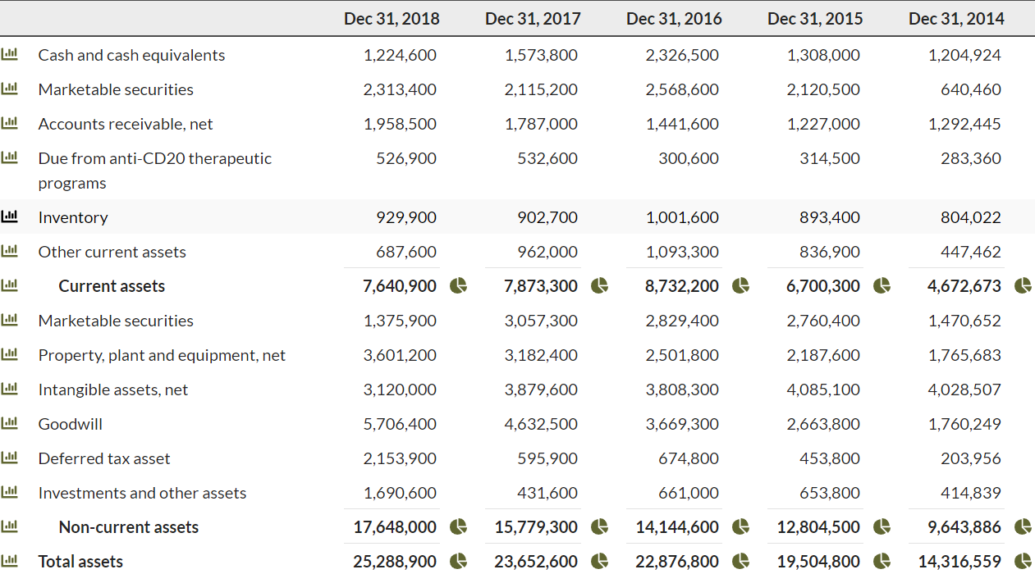
Biogen- Horizontal Analysis for Assets

Slide 28
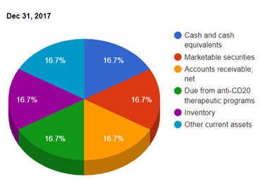
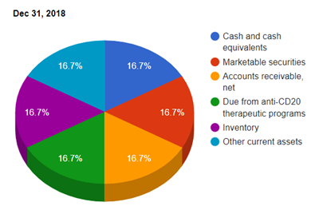
Biogen- Current Asset distribution

Slide 29
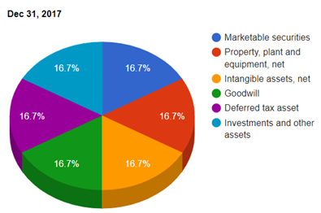
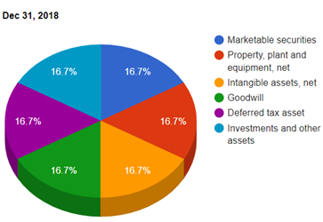
Biogen- Non Current Asset distribution

Slide 30
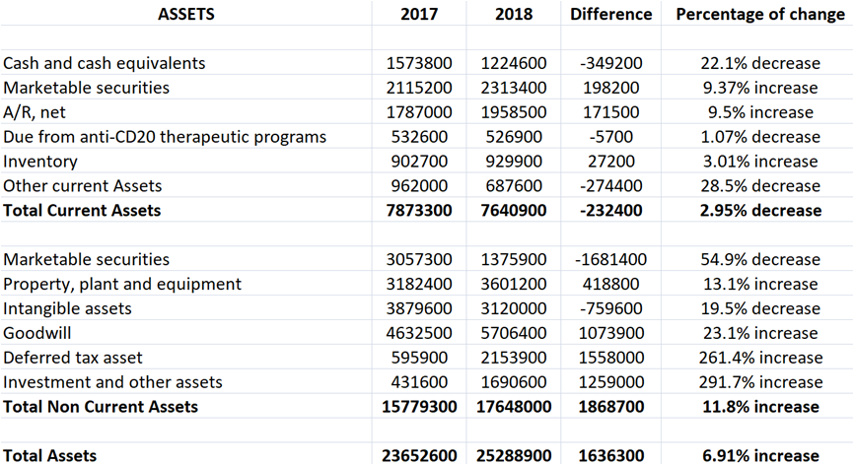
Biogen- Horizontal Analysis for Assets[13]

Slide 31
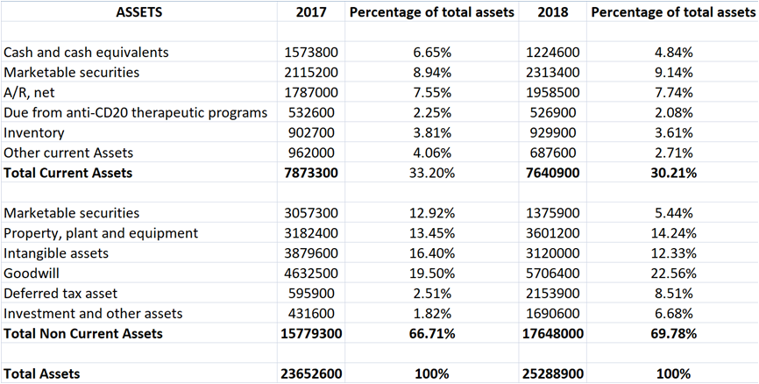
Biogen- Vertical Analysis for Assets[13]

Slide 32
Biogen- Summary of the analysis
Horizontal Analysis
The current assets which include cash, Accounts receivable, inventory etc. decreased by 2.95% in 2018 in comparison with 2017.
There was an increase in non current assets which includes intangible assets and other investments by 11.8% in 2018.
As a result, the total assets also increased by 6.91% from 2017 to 2018.

Slide 33
Biogen- Summary of the analysis
Vertical Analysis
The percentage of total current asset accounts decreased by 3% from 2017 to 2018.
Whereas the percentage of non current asset accounts increased by 3% to 69.7 in 2018.

Slide 34
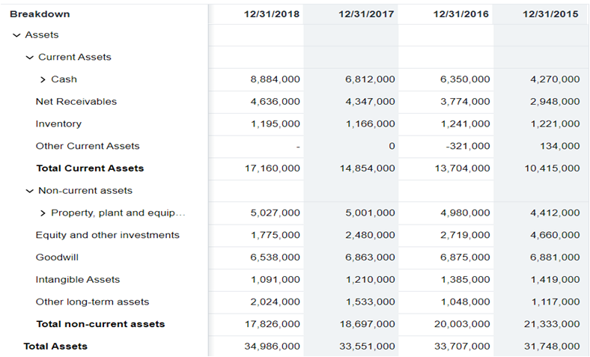
BMS- Horizontal Analysis for Assets

Slide 35
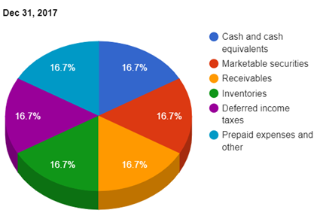
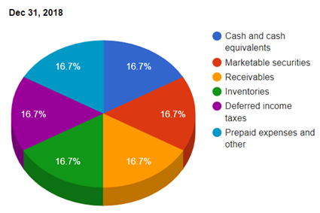
BMS- Current Asset distribution

Slide 36
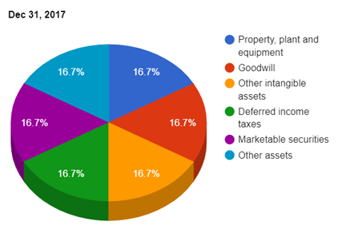
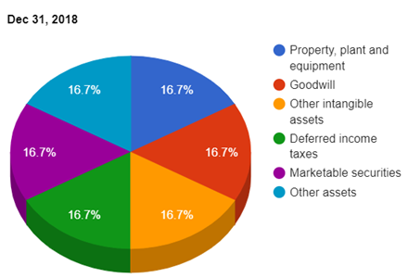
BMS- Non Current Asset distribution

Slide 37
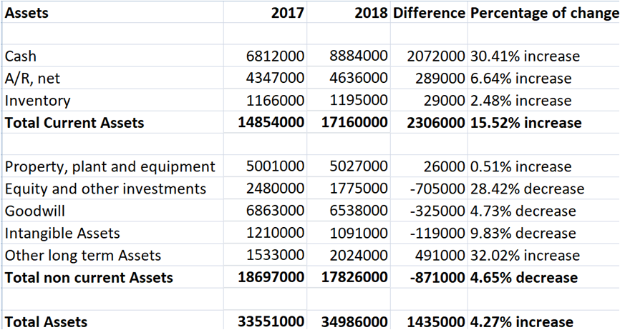
BMS- Horizontal Analysis for Assets[14]

Slide 38
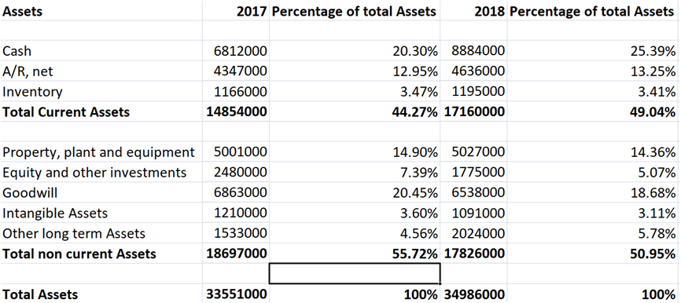
BMS- Vertical Analysis for Assets[14]

Slide 39
BMS- Summary of the analysis
Horizontal Analysis
The current assets which include cash, Accounts receivable, inventory etc. increased by 15.52% in 2018 in comparison with 2017.
There was a decrease in non current assets which includes intangible assets and other investments by 4.6% in 2018.
As a result, the total assets also increased by 4.27% from 2017 to 2018.

Slide 40
BMS- Summary of the analysis
Vertical Analysis
The percentage of total current asset accounts increased by 5% from 2017 to 2018.
Whereas the percentage of non current asset accounts decreased by 5% to 50.95 in 2018.

Slide 41
Key Ratio Analysis

Slide 42
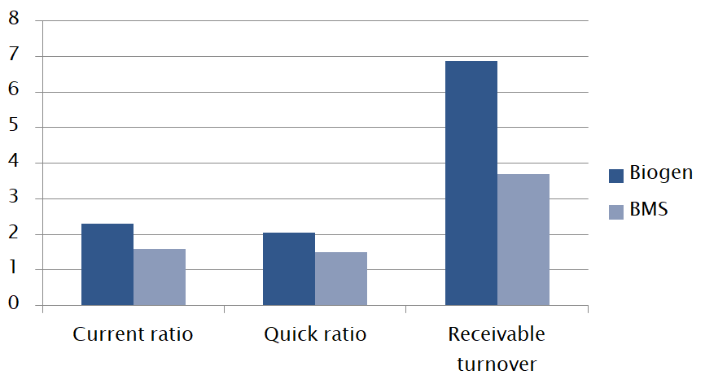
Liquidity ratios-2018[15][16]

Slide 43
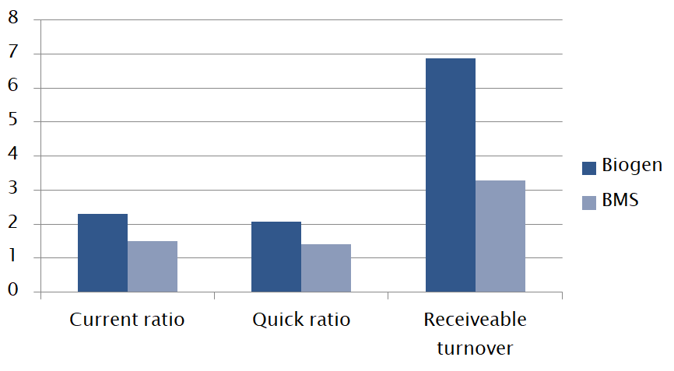
Liquidity ratios-2017[15][16]

Slide 44
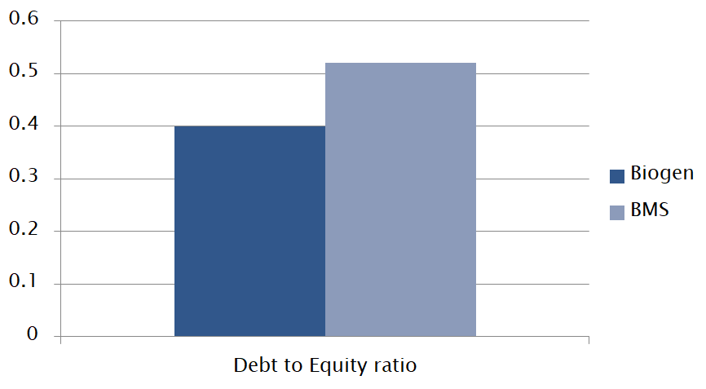
Solvency ratio-2018[15][16]

Slide 45
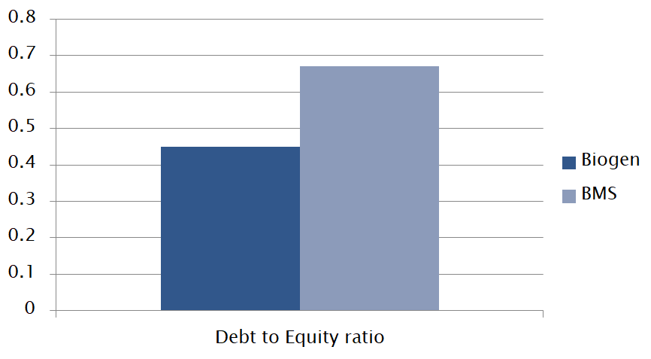
Solvency ratio-2017[15][16]

Slide 46
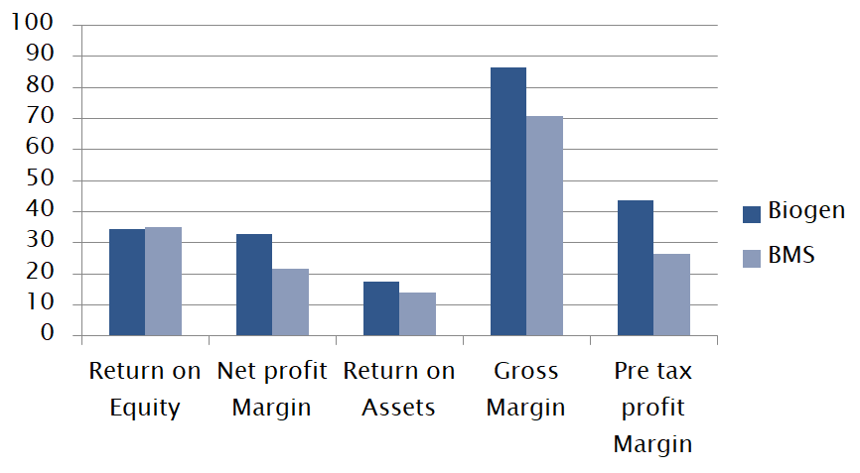
Profitability ratios-2018[15][16]

Slide 47
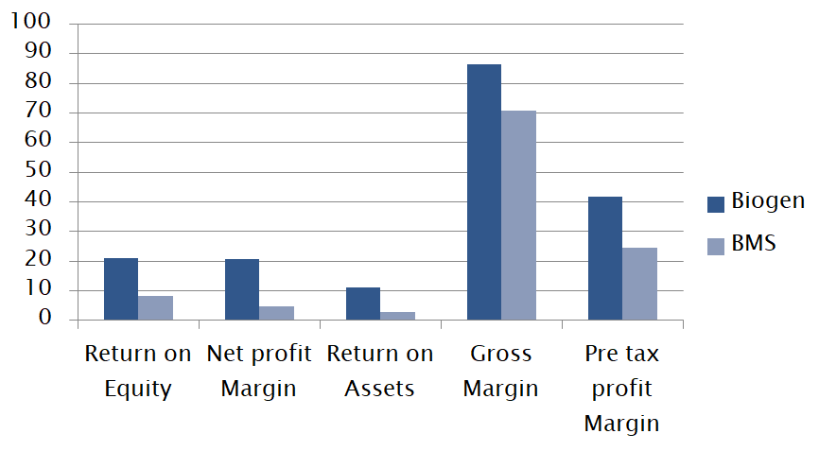
Profitability ratios-2017[15][16]

Slide 48
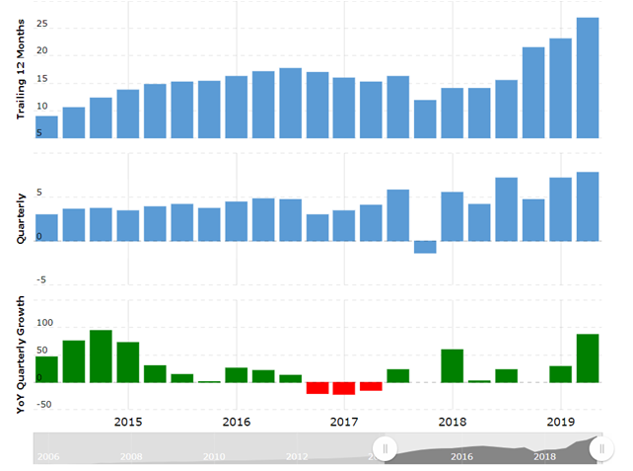
Biogen- Earnings per share[18]

Slide 49
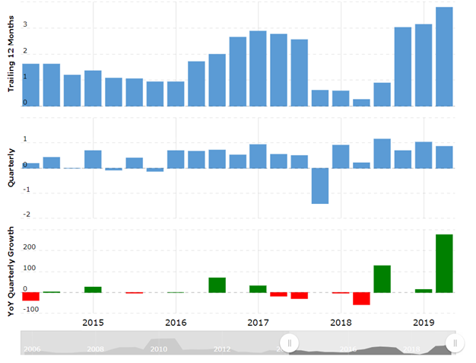
BMS- Earnings per share[19]

Slide 50
Factors of consideration for an Investor [17]
Biogen
Total revenue was increased by 8% in 2019 compared to 2018
GAAP Diluted EPS was $7.85
Non GAAP Diluted EPS was $9.15
Biogen lost 30% of its value in mid-March when the company scrapped two studies of of its late stage Alzheimer’s treatment.
On a single day the stocks rocketed 26% after the analysis showed that the drug might work
The company is also testing drugs for various treatments such as spinal muscular atrophy and is expects for its experimental Alzheimer’s drug in early 2020
Bristol Myers Squibb
Total revenue was increased by 10% in 2019 compared to 2018
GAAP Diluted EPS was $0.87
Non GAAP Diluted EPS was $1.18
BMY stock declined neary by 17% in 2018, that fall revenue was increased by 9% to $22.56 billion
Revlimid(cancer treatment)’s key patent is set to expire at year-end, Revlimid is a massive money-making drug in 2018 with with sales generated $9.67 billion
Major setback in 2019, as the company announced in July that the clinical study of Opdivo in combination with chemotherapy (NSCLC) didn’t meet its endpoint. A huge amount of company’s fortune is hinged on Opdivo
BMS to buyout biotech company Celenge

Slide 51
As Investor - Considering the factors we can
conclude the following:
Shares of either companies aren’t currently forming a definitive chart pattern but in comparison investing in seems more beneficial Biogen
For Biogen, the sales and earnings are growing but these is no guarantee that the Alzheimer’s drug would receive FDA’s approval
For BMS, Revlimid company’s key drug that generated 55% of revenue faces generic threats from competitors and any Celenge’s promising drug fail to win regulatory approval would be a big blow to BMY
To summarize,
As an investor buying stocks of Biogen would be advisable, considering the previous growth rate, sales, revenue and EPS of the company.
Also, the company is likely to receive the FDA approval for the Alzheimer’s drug which could change the dynamics of the company

Slide 52
Biogen[10]
Financial data of Q2:
Revenue increased by 8% and EPS by 88% as compared to Q2 of 2018
Added 4 new studies in Q2
Generated $2.0 billion net cash from operations
Acquired Nightstar Therapeutics
Repurchased 10.4 million shared
Biogen experienced total of $174.5 million loss in Q1 and Q2 of 2019

Slide 53
Biogen - As a Creditor [10]
I as a creditor would still give credit to Biogen based on their past records
Even though they observed loss, no clinical trial failed in Q2 and for pharmaceutical companies and that’s why so far drug approval is considered to be a positive sign
So I would lend Biogen a maximum amount of $500 million for 20 year period based on their current scenario and past records

Slide 54
BMS [11]
Financial data of Q2:
Revenue increased by 10% as compared to Q2 of 2018
Gross margin reduced by 68.2%
Expense reduced by
Acquired Celgene corporation
EPS of Q2 was $0.87
Research and development expenses reduced by 45%

Slide 55
BMS - As a Creditor [11]
Even though they observed loss, no clinical trial failed in Q2 and for pharmaceutical companies and that’s why so far drug approval is considered to be a positive sign
I as a creditor would still give credit to BMS because of its past records and returns but it won’t be a big amount
So I would lend BMS a maximum amount of $200 million for 10 year period based on their current scenario and past records

Slide 56
Conclusion
Net margin of Biogen increased by 41.31% vs that of BMS increased by 22.94%
Also as per horizontal analysis, total assets of Biogen increased by 6.91% while for BMS it increased by 4.27%
Biogen is more reliable from investment and in paying off its debts
Finally based on all of the comparisons, results show that financially Biogen is at a better state as compared to BMS

Slide 57
References
https://www.youtube.com/watch?v=dsfPOpE-GEs
https://www.marketresearchreports.com/blog/2019/01/31/global-pharmaceuticals-market-forecast-drivers-value-chain-analysis-trends
https://investmentbank.com/pharma-industry-overview/
https://www.bms.com/about-us/our-company/history-timeline.html
https://csimarket.com
https://www.marketwatch.com
https://finance.yahoo.com
https://markets.businessinsider.com/
https://www.biogen.com/en_us/history-overview.html
http://investors.biogen.com/static-files/a4a240f1-1484-49b6-b8d2-76129adfd183
https://s21.q4cdn.com/104148044/files/doc_financials/quarterly_reports/2019/q2/Q22019-Earnings-Release.pdf
https://investors.biogen.com/static-files/cba5fc1a-9ebc-469a-bd22-a3640eb3809b
https://www.stock-analysis-on.net/NASDAQ/Company/Biogen-Inc/Financial-Statement/Assets
https://finance.yahoo.com/quote/BMY/balance-sheet/
https://www.macrotrends.net/stocks/charts/BIIB/biogen/financial-ratios
https://www.macrotrends.net/stocks/charts/BMY/bristol-myers-squibb/financial-ratios
https://www.investors.com/news
https://www.macrotrends.net/stocks/charts/BIIB/biogen/eps-earnings-per-share-diluted
https://www.macrotrends.net/stocks/charts/BMY/bristol-myers-squibb/eps-earnings-per-share-diluted

